Slide 1

BRITISH AIRLINES
Sentiment Analysis

Slide 2
Key Insights
Positive Reviews: 46.60%
Negative Reviews: 51.50%
Neutral Reviews: 1.90%

Slide 3
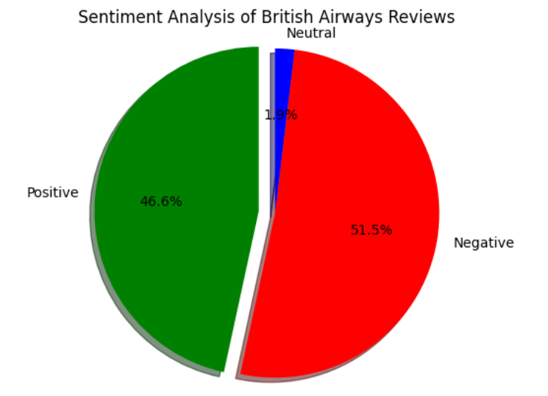
Visualisation

Slide 4
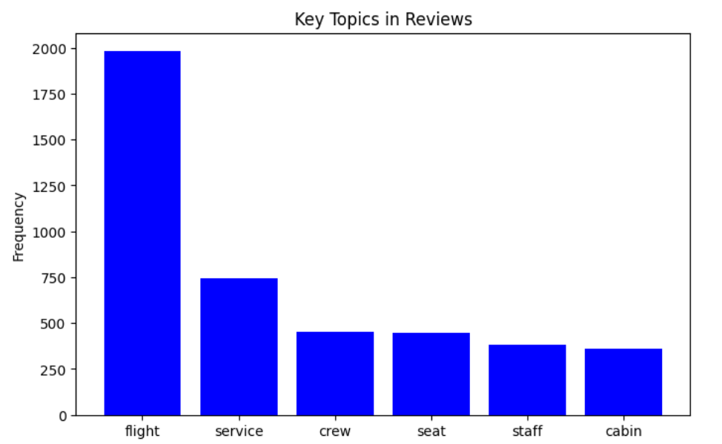
Repeating terms

